Slide 1
Chapter 2 Getting started
Hsu, Lih-Hsing

Slide 2
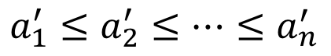
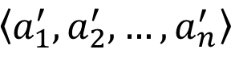
2.1 Insertion sort
Example: Sorting problem
Input: A sequence of n numbers
Output: A permutation of the input sequence such that .
The numbers to sort are known as the keys.
e.g. Input: 3, 7, 1, 9, 6, 5
Output: 1, 3, 5, 6, 7, 9
$$\left\langle a_{1}^{′},a_{2}^{′},…,a_{n}^{′}\right\rangle$$
$$a_{1}^{′}≤a_{2}^{′}≤…≤a_{n}^{′}$$

Slide 3
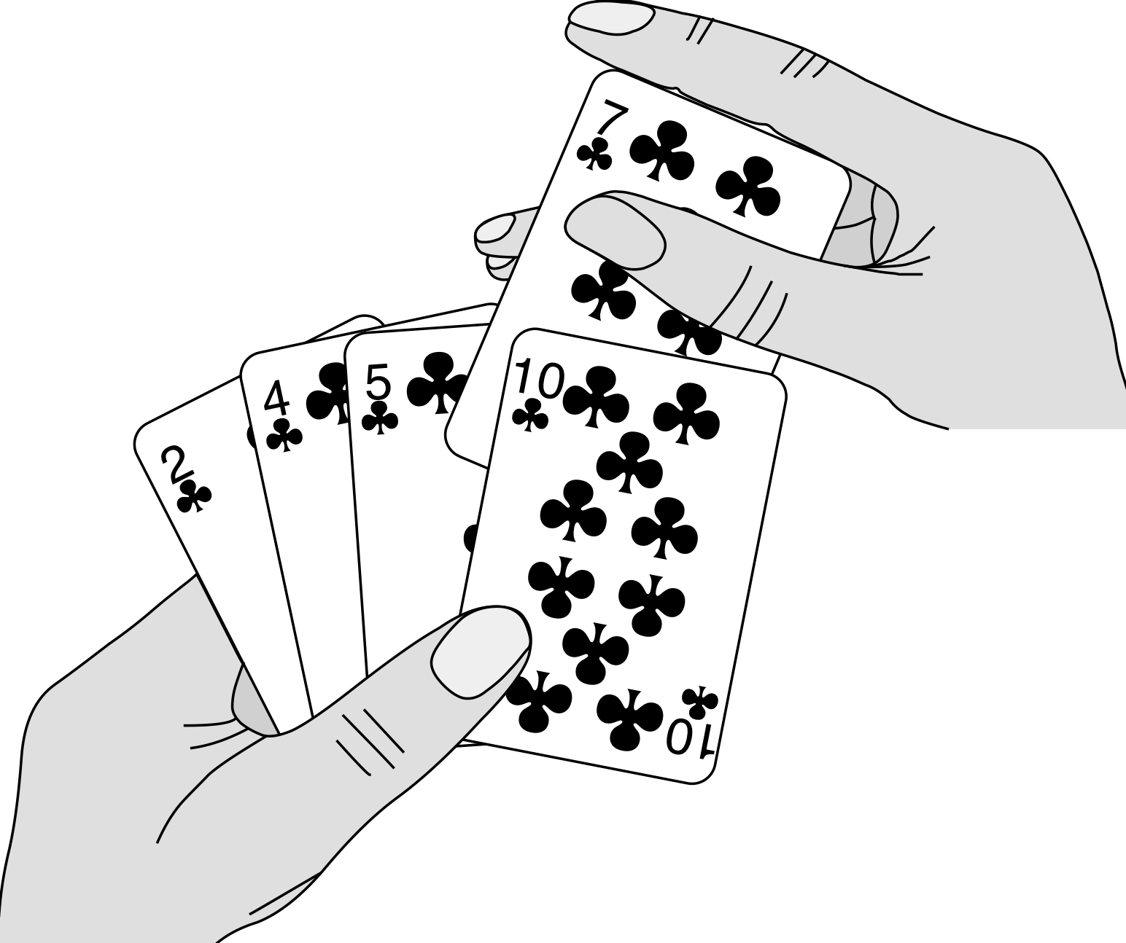
Pseudocode
Insertion sort
Insertion-sort(A)
1 for j ←2 to length[A]
2 do key←A[j]
3 Insert A[j] into the sorted sequence A[1..j-1]
4 i ← j - 1
5 while i>0 and A[i]>key
6 do A[i+1] ←A[i]
7 i ← i - 1
8 A[i +1] ←key

Slide 4
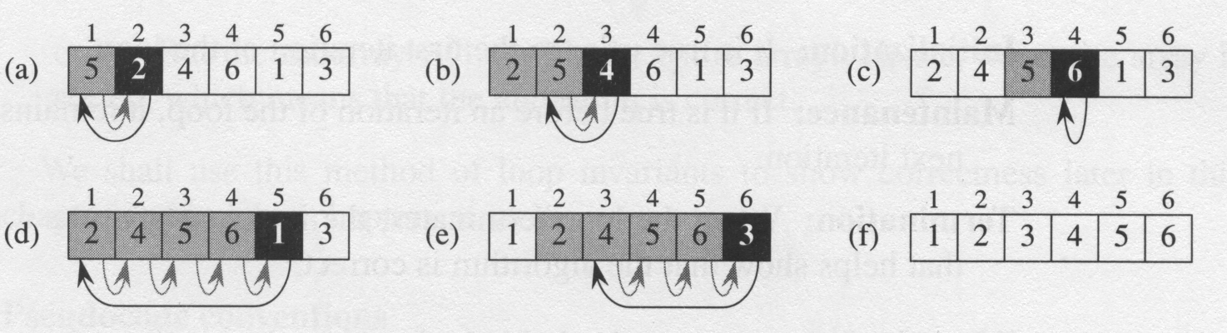
Operations of Insertion-Sort

Slide 5
Sorted in place :
The numbers are rearranged within the array A, with at most a constant number of them sorted outside the array at any time.
Loop invariant :
At the start of each iteration of the for loop of line 1-8, the subarray A[1..j-1] consists of the elements originally in A[1..j-1] but in sorted order.

Slide 6
Three things for loop invariant
Initialization: It is true prior to the first iteration of the loop.
Maintenance: If it is true before an iteration of the loop, it remains true before the next iteration.
Termination: When the loop terminates, the invariant gives us a useful property that helps show that the algorithm is correct.

Slide 7
2.2 Analysis of Algorithms
Analyzing an algorithm has come to mean predicting the resources that the algorithm requires
Resources: memory, communication, bandwidth, logic gate, time.
Assumption: one processor, RAM
(We shall have occasion to investigate models for parallel computers and digital hardware.)

Slide 8
2.2 Analyzing algorithms
The best notion for input size depends on the problem being studied.
The running time of an algorithm on a particular input is the number of primitive operations or “steps” executed
It is convenient to define the notion of step so that it is as machine-independent as possible

Slide 9
Insertion-sort(A) cost times
1 for j ←2 to length[A] C₁ n
2 do key←A[j] C₂ n-1
3 ∗Insert A[j] into the
sorted sequence A[1..j -1]
4 i ←j -1 C₄ n-1
5 while i>0 and A[i]>key C₅
6 do A[i +1] ←A[i] C₆
7 i ←i -1 C₇
8 A[i +1] ←key C₈
t_{j} is the number of times the while loop test in line 5 is executed for the value of j.

Slide 10
Running Time
for j = 2,3,…, n : Linear function on n

Slide 11
Running Time
for j = 2, 3, …, n :
quadratic function on n.

Slide 12
Worst-case and average-case analysis
Usually, we focus on finding only the worst-case running time
Reason:
It is an upper bound on the running time
The worst case occurs fair often
The average case is often as bad as the worst case. For example, the insertion sort. Again, quadratic function.

Slide 13
Order of growth
In some particular cases, we shall be interested in average-case, or expected running time of an algorithm.
It is the rate of growth, or order of growth, of the running time that really interests us.

Slide 14
2.3 Designing algorithms
There are many ways to the design of algorithms:
Incremental approach: insertion sort
Divide-and-conquer: merge sort
recursion:
divide
conquer
combine

Slide 15
Merge(A, p, q, r)
1 n₁ ← q – p + 1
2 n₂ ← r – q
3 create array L[1:n₁+1] and R[1:n₂+1]
4 for i ← 1 to n₁
5 do L[ i ] ←A[ p + i – 1 ]
6 for j ← 1 to n₂
7 do R[ i ] ←A[ q + j ]
8 L[n₁ + 1] ← ∞
9 R[n₂ + 1] ← ∞

Slide 16
Merge(A, p, q, r)
10 i ←1
11 j ←1
12 for k ← p to r
13 do if L[ i ] ≤ R[ j ]
14 then A[ k ] ← L[ i ]
15 i ← i + 1
16 else A[ k ] ← R[ j ]
17 j ← j + 1

Slide 17
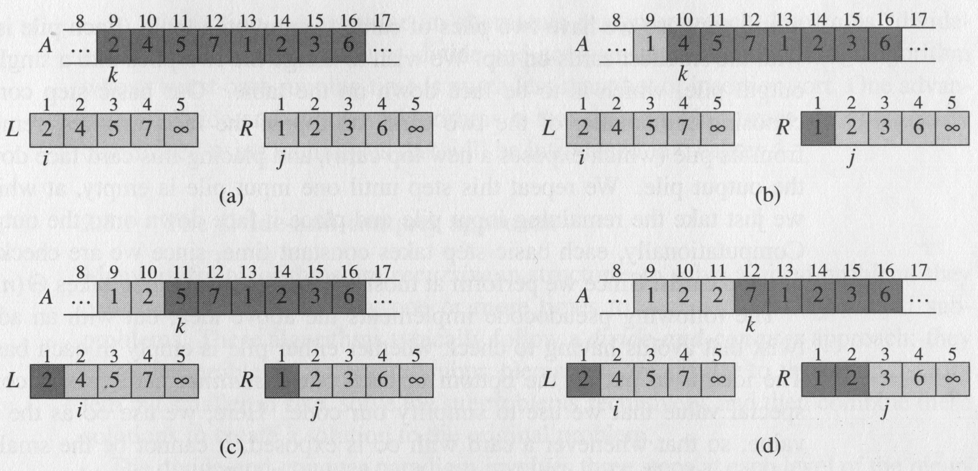
Merge of Two Sorted Lists

Slide 18
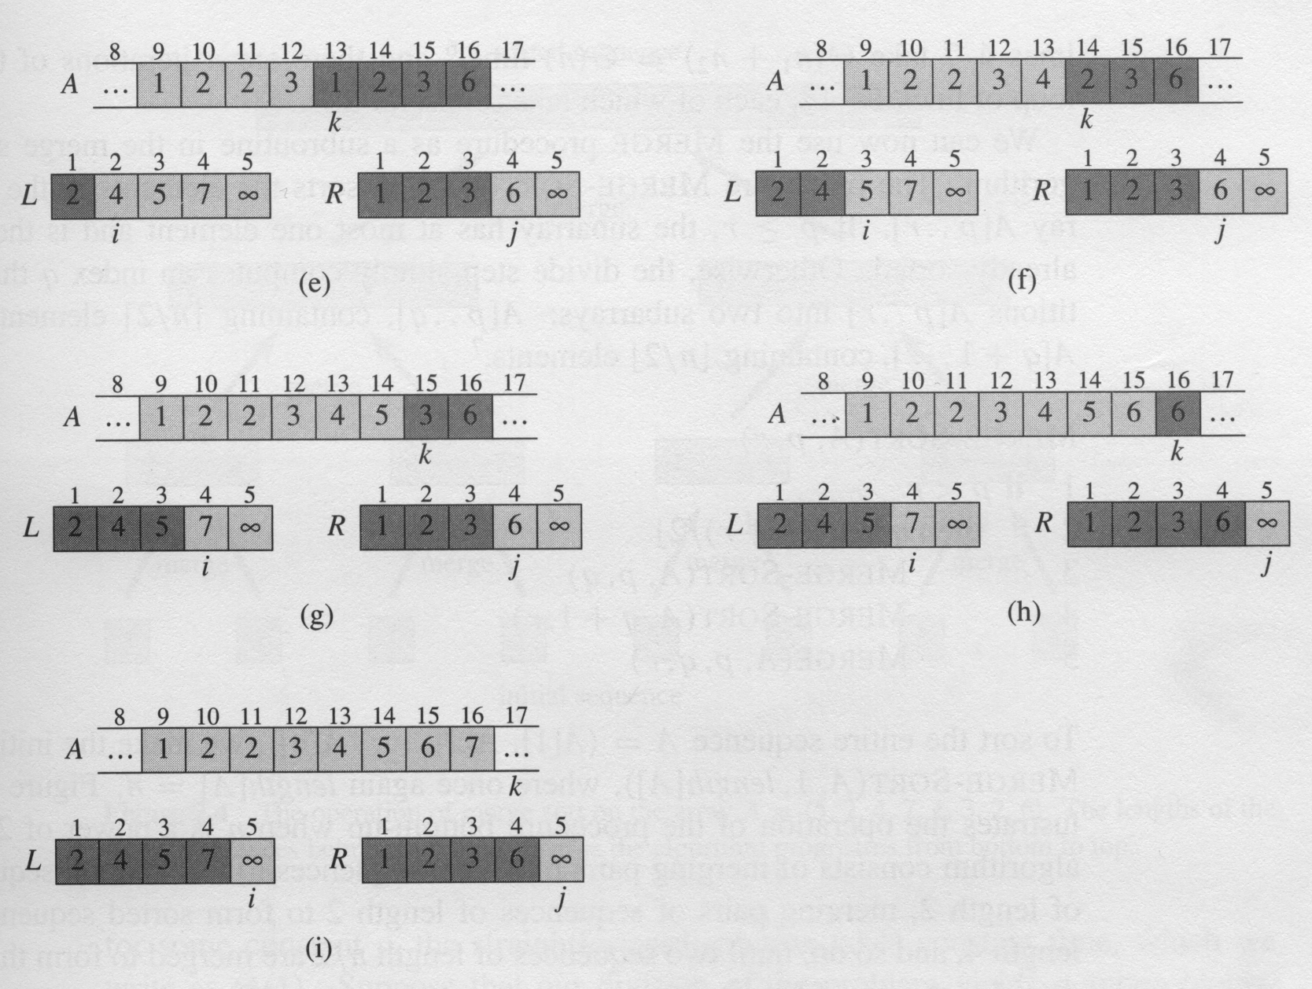

Slide 19
MERGE-SORT(A, p, r)
1 if p < r
2 then q←⎣(p+r)/2⎦
3 MERGE-SORT(A, p, q)
4 MERGE-SORT(A, q+1, r)
5 MERGE(A, p, q, r)

Slide 20
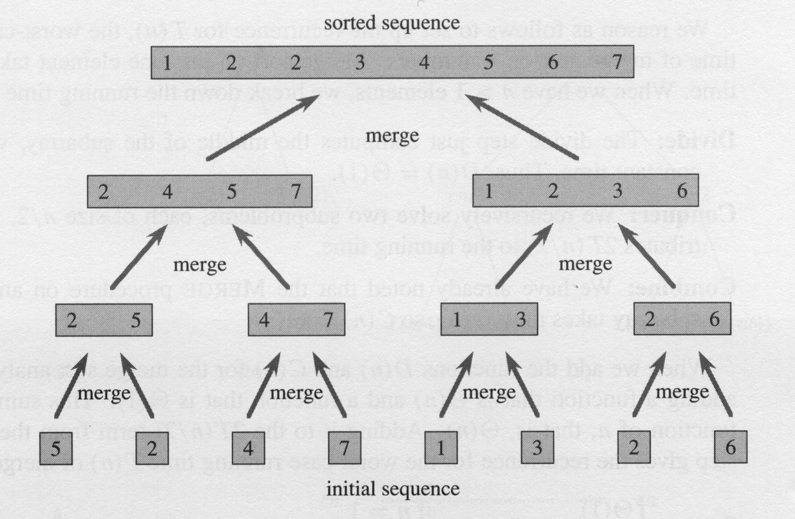

Slide 21
Analysis of merge sort
Analyzing divide-and-conquer algorithms
See Chapter 4
Analysis of merge sort

Slide 22
Analysis of merge sort
where the constant c represents the time required to solve problems of size 1 as well as the time per array element of the divide and combine steps.

Slide 23
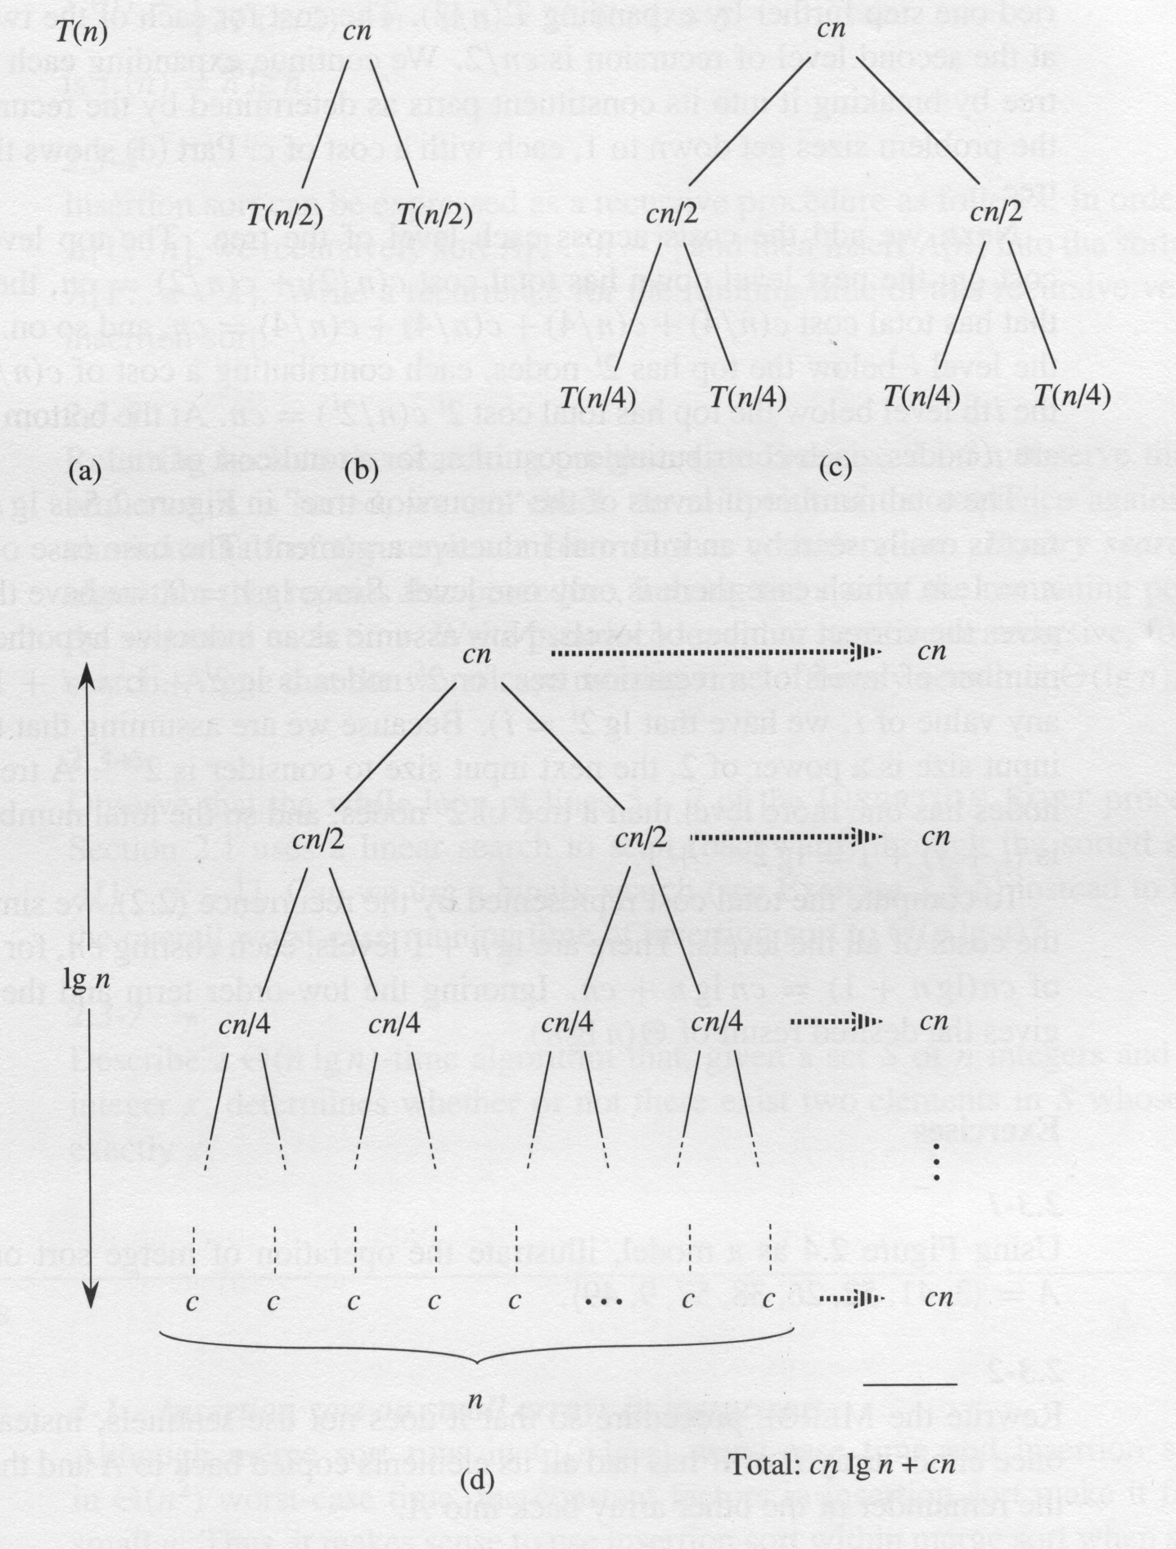

Slide 24
Merge Sort outperforms Insertion Sort!

Slide 25
Required Run Time of Algorithms
For a sorting problem of n items, there are n! distinct input permutations (or, what about an infinite number of input permutations?)
Categories of the required run time of algorithm A for Sorting:
Worst-case: What input permutation is most unfavorable to algorithm A?
Best-case: What input permutations favors algorithm A most?
Average-case: Expected run time over equal probabilities among all input permutations

Slide 26
Be cautious about run time categories
when saying
Algorithm A outperforms Algorithm B
Merge Sort:
Worst case $≈$ n log n
Best case $≈$ n log n
Average case $≈$ n log n
Insertion Sort:
Worst case $≈$ n²
Best case $≈$ n
Average case $≈$ n²

